Slide 1
Disorders of neuromuscular junction

Slide 2
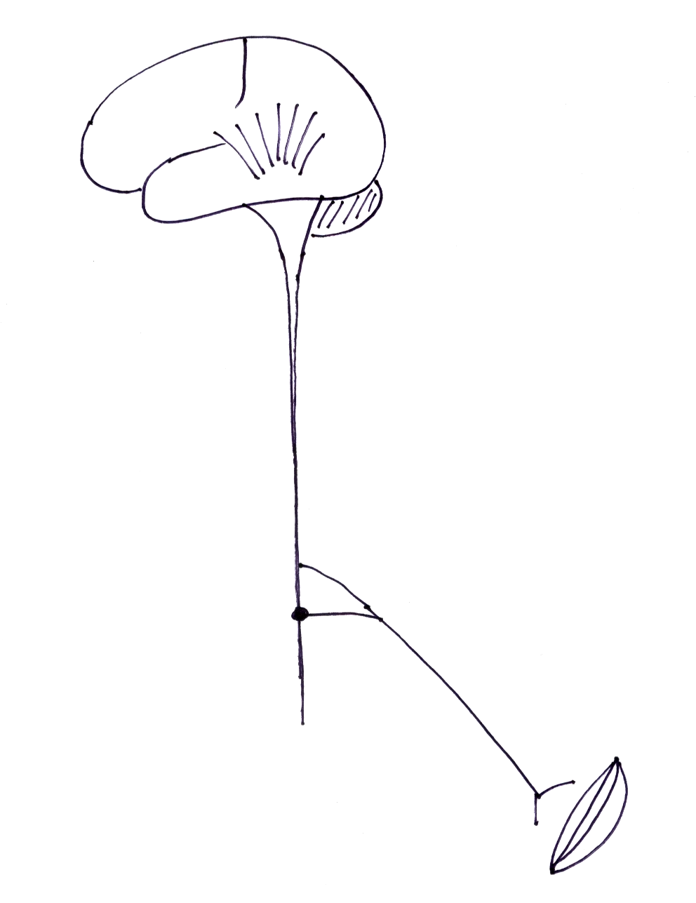
Disorders of NMJ
motor - proximal weakness
  bilateral, symmetrical
fatiguability
NO sensory loss
eg; myasthenia gravis
neuro-muscular
junction

Slide 3
Disorders of NMJ
myasthenia gravis
LEMS - Lambert-Eaton myasthenic syndrome
drug induced myasthenic syndromes
snake bite
organophosphate poisoning
botulism

Slide 4
Myasthenia gravis
What are the main features?

Slide 5
Myasthenia gravis
auto-antibodies against ACh receptors on post synaptic membrane – 80-90%

Slide 6
Myasthenia gravis
auto-antibodies against ACh receptors on post synaptic membrane – 80-90%
associated with thymic abnormalities
  thymic hyperplasia - 50%
  thymic tumour (paraneoplastic) - 10%
other immunological abnormalities
  other auto-Abs – anti-MuSK
  ass. with other autoimmune diseases – thyroid, SLE, rheumatoid dis.

Slide 7
Myasthenia gravis – clinical features

Slide 8
Myasthenia gravis – clinical features
motor weakness
  limbs - bilateral, proximal
  extraocular - diplopia, ptosis - (ocular myasthenia vs. generalized)
  facial, bulbar, neck muscles
  respiratory
fatiguability
  ↑ with activity, ↓ with rest
  diurnal variation
reflexes - normal
sensory - normal

Slide 9
Myasthenia gravis - types
early onset - < 40 yrs, females > males
  AChR antibody +ve, other organ specific Ab’s
  thymic hyperplasia
late onset - > 40 yrs, males > females
  AChR antibody +ve
  no thymic hyperplasia
thymoma associated - 10%, any age – 30-50 yrs
sero-negative MG -
  AChR antibody –ve, MuSK antibody +ve
  females, prominent bulbar + respiratory involvement

Slide 10
Myasthenia gravis - diagnosis

Slide 11
Myasthenia gravis - diagnosis
Edrophonium (tensilon) test
Ice pack test
EMG – repetitive stimulation - decrement pattern single fibre EMG
Immunological
  ACh Receptor antibody - +ve in 85%
  anti MuSK Ab - (in AChR Ab -ve patients)
look for thymoma
  CXR, CT chest

Slide 12
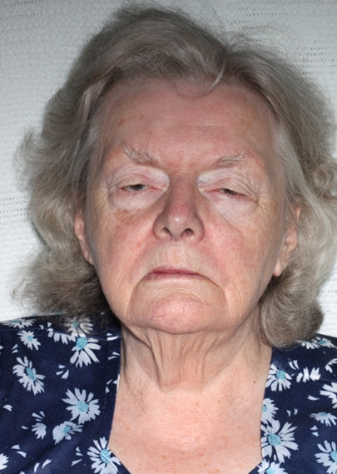
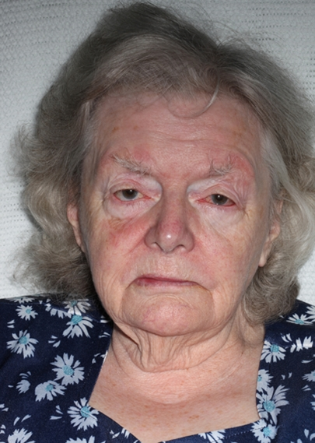

Positive ice pack test

Slide 13
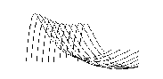
repetitive stimulation at low rates - decremental response

Slide 14
Myasthenia gravis - treatment
symptomatic treatment
  AChE inhibitors - neostigmine, pyridostigmine
immuno-modulation
  steroids - prednisolone
  azathioprine, cyclophosphamide
  plasma exchange, IvIG - for rapid relief - in crises, before surgery
thymectomy
  more benefit in thymic hyperplasia > thymoma

Slide 15
Myasthenia gravis - crises
acute exacerbation with respiratory & bulbar dysfunction
myasthenic crisis
cholinergic crisis

Slide 16
Drugs and myasthenia gravis
drug induced myasthenia
  penicillamine
drugs can exacerbate myasthenia
  neuromuscular blockers
  antibiotics - aminoglycosides, erythromycin, clindamycin, ampicillin, ciprofloxacin
  cardiac drugs - quinidine, procainamide, verapamil, beta blockers
  other - quinine, chloroquine, phenytoin, lithium

